Slide 1
UPGMA
Shane Kimble
KyOSS 01/07/2019

Slide 2
Phylogeny
The evolutionary development and history of a species or higher taxonomic grouping of organisms.
Note: Biological evolution is defined as the change in allele frequencies in a population, over time.
Allele: The possible variants of a gene

Slide 3
UPGMA
Unweighted Pair Group Method with Arithmetic Mean
Hierarchical Clustering resulting in a rooted tree
Input: Distance Matrix
Output: Rooted Tree
The general idea is to iteratively cluster the smallest values, then replace the two values with one mean value.

Slide 4
Where do distance matrices come from?
The Central Dogma of Molecular Biology:

Slide 5
Distance Matrix: Example
Consider the following amino acid sequences for the Sonic hedgehog protein:
Junglefowl: “MVEMLLLTRILLVGFICALL…”
Zebrafish: "MRLLTRVLLVSLLTLSLVVSGLA…”
Coelacanth: “MDEMLLLTRIVLVGLICSSLVS…”
Flounder: “MLLWTRIVLAGVICLSLVSSG…”
Carp: “MRLMTRVLLVSLLSLSLVVSGLAC…”
Skate: “MMLTRIVLVGLVCCSLFSSARACG…”
…

Slide 6
Distance Matrix: Example
For each pair of vertebrates, calculate the pairwise difference, then reorganize to square form.
{'Red Junglefowl vs. Zebrafish': 403, 'Red Junglefowl vs. Indonesian Coelacanth': 174, 'Red Junglefowl vs. Olive Flounder': 406, 'Red Junglefowl vs. Carp': 403, 'Red Junglefowl vs. Little Skate': 398, 'Red Junglefowl vs. Mouse': 411, 'Red Junglefowl vs. Chimpanzee': 197, 'Red Junglefowl vs. Human': 430, 'Zebrafish vs. Indonesian Coelacanth': 397, 'Zebrafish vs. Olive Flounder': 138, 'Zebrafish vs. Carp': 36, 'Zebrafish vs. Little Skate': 359, 'Zebrafish vs. Mouse': 409, 'Zebrafish vs. Chimpanzee': 433, 'Zebrafish vs. Human': 221, 'Indonesian Coelacanth vs. Olive Flounder': 397, 'Indonesian Coelacanth vs. Carp': 395, 'Indonesian Coelacanth vs. Little Skate': 395, 'Indonesian Coelacanth vs. Mouse': 409, 'Indonesian Coelacanth vs. Chimpanzee': 209, 'Indonesian Coelacanth vs. Human': 438, 'Olive Flounder vs. Carp': 139, 'Olive Flounder vs. Little Skate': 343, 'Olive Flounder vs. Mouse': 407, 'Olive Flounder vs. Chimpanzee': 443, 'Olive Flounder vs. Human': 241, 'Carp vs. Little Skate': 356, 'Carp vs. Mouse': 412, 'Carp vs. Chimpanzee': 432, 'Carp vs. Human': 222, 'Little Skate vs. Mouse': 407, 'Little Skate vs. Chimpanzee': 438, 'Little Skate vs. Human': 428, 'Mouse vs. Chimpanzee': 434, 'Mouse vs. Human': 426, 'Chimpanzee vs. Human': 426}
{'Red Junglefowl': (0, 403, 174, 406, 403, 398, 411, 197, 430), 'Zebrafish': (403, 0, 397, 138, 36, 359, 409, 433, 221), 'Indonesian Coelacanth': (174, 397, 0, 397, 395, 395, 409, 209, 438), 'Olive Flounder': (406, 138, 397, 0, 139, 343, 407, 443, 241), 'Carp': (403, 36, 395, 139, 0, 356, 412, 432, 222), 'Little Skate': (398, 359, 395, 343, 356, 0, 407, 438, 428), 'Mouse': (411, 409, 409, 407, 412, 407, 0, 434, 426), 'Chimpanzee': (197, 433, 209, 443, 432, 438, 434, 0, 426), 'Human': (430, 221, 438, 241, 222, 428, 426, 426, 0)}
 | Red Junglefowl | Zebrafish | Indonesian Coelacanth | Olive Flounder | Carp | Little Skate | Mouse | Chimpanzee | Human
Red Junglefowl | 0 | 403 | 174 | 406 | 403 | 398 | 411 | 197 | 430
Zebrafish | 403 | 0 | 397 | 138 | 36 | 359 | 409 | 433 | 221
Indonesian Coelacanth | 174 | 397 | 0 | 397 | 395 | 395 | 409 | 209 | 438
Olive Flounder | 406 | 138 | 397 | 0 | 139 | 343 | 407 | 443 | 241
Carp | 403 | 36 | 395 | 139 | 0 | 356 | 412 | 432 | 222
Little Skate | 398 | 359 | 395 | 343 | 356 | 0 | 407 | 438 | 428
Mouse | 411 | 409 | 409 | 407 | 412 | 407 | 0 | 434 | 426
Chimpanzee | 197 | 433 | 209 | 443 | 432 | 438 | 434 | 0 | 426
Human | 430 | 221 | 438 | 241 | 222 | 428 | 426 | 426 | 0

Slide 7
UPGMA
Input: Distance Matrix
Square Matrix of pairwise distances. The numbers are the total differences between amino acids for a particular protein.
The provided example is for Cytochrome C, an essential component of energy transfer.
 | Turtle | Man | Tuna | Chicken | Moth | Monkey | Dog
Turtle | 0 | 19 | 27 | 8 | 33 | 18 | 13
Man | 19 | 0 | 31 | 18 | 36 | 1 | 13
Tuna | 27 | 31 | 0 | 26 | 41 | 32 | 29
Chicken | 8 | 18 | 26 | 0 | 31 | 17 | 14
Moth | 33 | 36 | 41 | 31 | 0 | 35 | 28
Monkey | 18 | 1 | 32 | 17 | 35 | 0 | 12
Dog | 13 | 13 | 29 | 14 | 28 | 12 | 0

Slide 8
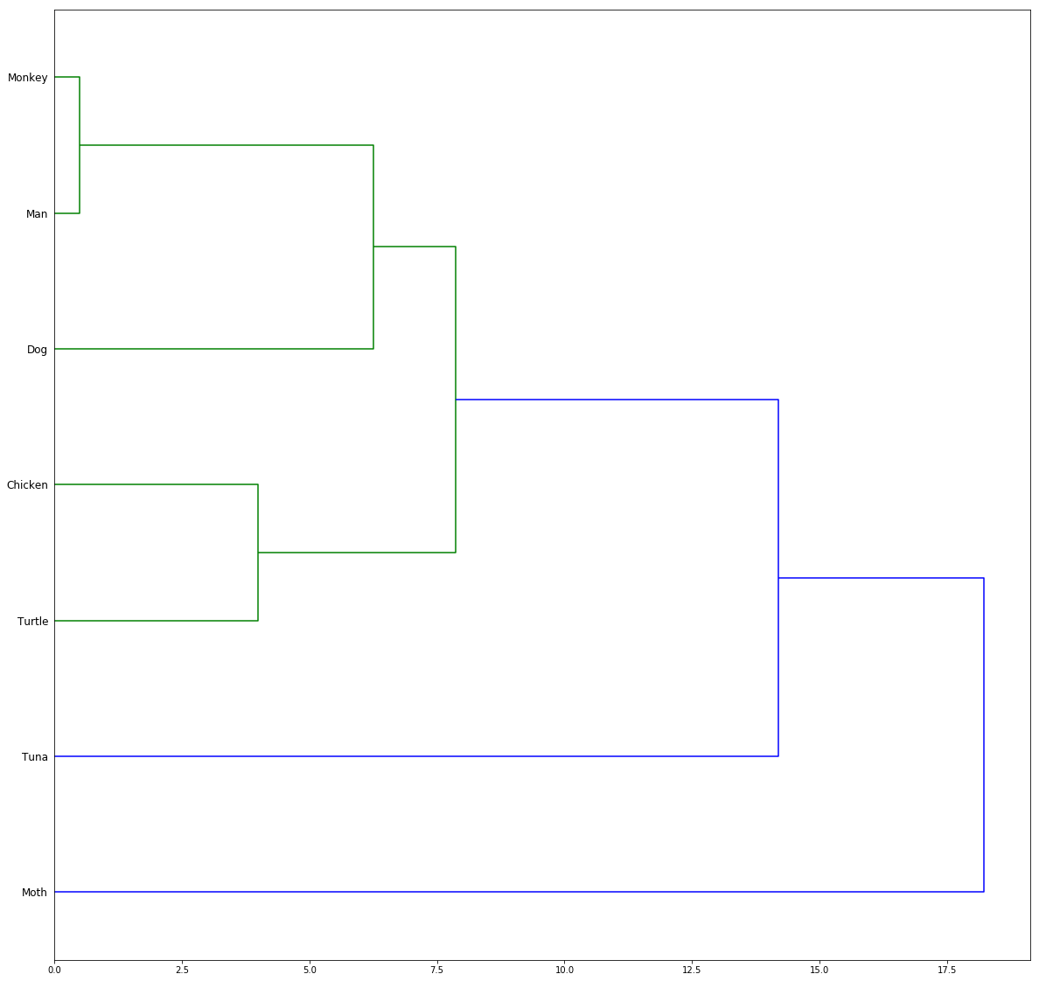
UPGMA
Output: Rooted Tree
Using the branch lengths below:
{('Man', 'Monkey'): 0.5,
('Turtle', 'Chicken'): 4.0,
(('Man', 'Monkey'), 'Dog'): 6.25,
(('Turtle', 'Chicken'), (('Man', 'Monkey'), 'Dog')): 7.875,
((('Turtle', 'Chicken'), (('Man', 'Monkey'), 'Dog')), 'Tuna'): 14.1875,
(((('Turtle', 'Chicken'), (('Man', 'Monkey'), 'Dog')), 'Tuna'), 'Moth'): 18.21875}

Slide 9
1. Cluster Man and Monkey
Red = Cluster & record mean (Divide non-zero value by 2)
Yellow = Update with mean
 | Turtle | Man | Tuna | Chicken | Moth | Monkey | Dog
Turtle | 0 | 19 | 27 | 8 | 33 | 18 | 13
Man | 19 | 0 | 31 | 18 | 36 | 1 | 13
Tuna | 27 | 31 | 0 | 26 | 41 | 32 | 29
Chicken | 8 | 18 | 26 | 0 | 31 | 17 | 14
Moth | 33 | 36 | 41 | 31 | 0 | 35 | 28
Monkey | 18 | 1 | 32 | 17 | 35 | 0 | 12
Dog | 13 | 13 | 29 | 14 | 28 | 12 | 0

Slide 10
2. Cluster Turtle and Chicken
Red = Cluster & record mean (Divide non-zero value by 2)
Yellow = Update with mean
 | Turtle | ('Man', 'Monkey') | Tuna | Chicken | Moth | Dog
Turtle | 0 | 18.5 | 27 | 8 | 33 | 13
('Man', 'Monkey') | 18.5 | 0 | 31.5 | 17.5 | 35.5 | 12.5
Tuna | 27 | 31.5 | 0 | 26 | 41 | 29
Chicken | 8 | 17.5 | 26 | 0 | 31 | 14
Moth | 33 | 35.5 | 41 | 31 | 0 | 28
Dog | 13 | 12.5 | 29 | 14 | 28 | 0

Slide 11
3. Cluster (Man, Monkey) and Dog
Red = Cluster & record mean (Divide non-zero value by 2)
Yellow = Update with mean
 | ('Turtle', 'Chicken') | ('Man', 'Monkey') | Tuna | Moth | Dog
('Turtle', 'Chicken') | 0 | 18 | 26.5 | 32 | 13.5
('Man', 'Monkey') | 18 | 0 | 31.5 | 35.5 | 12.5
Tuna | 26.5 | 31.5 | 0 | 41 | 29
Moth | 32 | 35.5 | 41 | 0 | 28
Dog | 13.5 | 12.5 | 29 | 28 | 0

Slide 12
4. Cluster (Turtle, Chicken) and ((Man, Monkey), Dog)
Red = Cluster & record mean (Divide non-zero value by 2)
Yellow = Update with mean
 | ('Turtle', 'Chicken') | (('Man', 'Monkey'), 'Dog') | Tuna | Moth
('Turtle', 'Chicken') | 0 | 15.75 | 26.5 | 32
(('Man', 'Monkey'), 'Dog') | 15.75 | 0 | 30.25 | 31.75
Tuna | 26.5 | 30.25 | 0 | 41
Moth | 32 | 31.75 | 41 | 0

Slide 13
5. Cluster ((Turtle, Chicken), ((Man, Monkey), Dog)) and Tuna
Red = Cluster & record mean (Divide non-zero value by 2)
Yellow = Update with mean
 | ((Turtle, Chicken), ((Man, Monkey), Dog)) | Tuna | Moth
((Turtle, Chicken), ((Man, Monkey), Dog)) | 0 | 28.375 | 31.875
Tuna | 28.375 | 0 | 41
Moth | 31.875 | 41 | 0

Slide 14
6. Cluster ((('Turtle', 'Chicken'), (('Man', 'Monkey'), 'Dog')), 'Tuna’) and Moth
Red = Cluster & record mean (Divide non-zero value by 2)
 | ((('Turtle', 'Chicken'), (('Man', 'Monkey'), 'Dog')), 'Tuna') | Moth
((('Turtle', 'Chicken'), (('Man', 'Monkey'), 'Dog')), 'Tuna') | 0 | 36.4375
Moth | 36.4375 | 0

Slide 15
7. Create Dendrogram
Output: Rooted Tree
Using the branch lengths below:
{('Man', 'Monkey'): 0.5,
('Turtle', 'Chicken'): 4.0,
(('Man', 'Monkey'), 'Dog'): 6.25,
(('Turtle', 'Chicken'), (('Man', 'Monkey'), 'Dog')): 7.875,
((('Turtle', 'Chicken'), (('Man', 'Monkey'), 'Dog')), 'Tuna'): 14.1875,
(((('Turtle', 'Chicken'), (('Man', 'Monkey'), 'Dog')), 'Tuna'), 'Moth'): 18.21875}

Slide 16
Advantages & Disadvantages
Advantages:
Easy, unsupervised, deterministic classification
Compliments other analyses, notably sequence alignment
Disadvantages:
Assumes a constant rate of biological evolution
Only accounts for sequential data, and not observable reality
Especially phenotypes (physical traits)
Amino acid differences are all treated equally

Slide 17
Questions?
Email me: skimble@edjanalytics.com
Message me on Slack (Shane Kimble): Louisville Tech, Code Louisville
Follow me on Github: https://github.com/summonholmes

